Slide 1

Module 3:
Elliptic
Curve
Cryptography

Slide 3

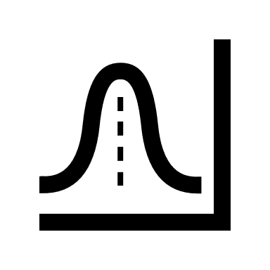


03
02
04
01
1
Visualization
A Real Example
Definition
Any Downside?
Agenda
What is an Elliptic Curve?
What is Elliptic Curve Cryptography?
Let’s see how it actually works
2
Strengths and Weaknesses
Practical Implications
Let’s see a real example
3
4

Slide 4
03
02
04
01
1
Visualization
A Real Example
Any Downside?
Definition
What is an Elliptic Curve?
What is Elliptic Curve Cryptography?
Let’s see how it actually works
2
Strengths and Weaknesses
Practical Implications
Let’s see a real example
3
4

Slide 5
03
01
02
04
1
Visualization
Definition
A Real Example
Any Downside?
What is an Elliptic Curve?
What is Elliptic Curve Cryptography?
Let’s see how it actually works
2
Strengths and Weaknesses
Practical Implications
Let’s see a real example
3
4

Slide 6
02
03
01
04
1
A Real Example
Visualization
Definition
Any Downside?
What is an Elliptic Curve?
What is Elliptic Curve Cryptography?
2
Let’s see how it actually works
Strengths and Weaknesses
Practical Implications
Let’s see a real example
3
4

Slide 7
03
02
04
01
1
Visualization
A Real Example
Any Downside?
Definition
What is an Elliptic Curve?
What is Elliptic Curve Cryptography?
Let’s see how it actually works
2
Strengths and Weaknesses
Practical Implications
Let’s see a real example
3
4

Slide 8
03
02
04
01
1
Visualization
A Real Example
Any Downside?
Definition
What is an Elliptic Curve?
What is Elliptic Curve Cryptography?
Let’s see how it actually works
2
Strengths and Weaknesses
Practical Implications
Let’s see a real example
3
4

Slide 9
Definition
An elliptic curve is the set of points that satisfy a specific mathematical equation. The equation for an elliptic curve looks something like this:
y² = x³ + ax + b

Slide 10

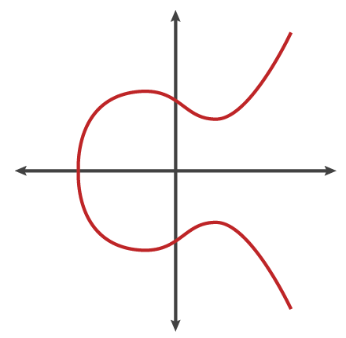


Definition
That graphs to something that looks a bit like this:
There are other representations of elliptic curves, but technically an elliptic curve is the set of points satisfying an equation in two variables with degree two in one of the variables and three in the other. An elliptic curve is not just a pretty picture, it also has some properties that make it a good setting for cryptography.

Slide 11

Horizontal Symmetry
Take a closer look at the elliptic curve plotted above. It has several interesting properties.
One of these is horizontal symmetry. Any point on the curve can be reflected over the x axis and remain the same curve. A more interesting property is that any non-vertical line will intersect the curve in at most three places.
Let's imagine this curve as the setting for a game of billiards. Take any two points on the curve and draw a line through them, it will intersect the curve at exactly one more place. In this game of billiards, you take a ball at point A, shoot it towards point B. When it hits the curve, the ball bounces either straight up (if it's below the x-axis) or straight down (if it's above the x-axis) to the other side of the curve.

Slide 12
Horizontal Symmetry
We can call this billiards move on two points "dot." Any two points on a curve can be dotted together to get a new point.
A dot B = C
We can also string moves together to "dot" a point with itself over and over.
A dot A = B
A dot B = C
A dot C = D
...
It turns out that if you have two points, an initial point "dotted" with itself n times to arrive at a final point, finding out n when you only know the final point and the first point is hard.

Slide 13
How difficult is it to break into it?
Imagine one person plays our game alone in a room for a random period of time. It is easy for him to hit the ball over and over following the rules described above.
If someone walks into the room later and sees where the ball has ended up, even if they know all the rules of the game and where the ball started, they cannot determine the number of times the ball was struck to get there without running through the whole game again until the ball gets to the same point. Easy to do, hard to undo: this is the basis for a very good Trapdoor Function.

Slide 14
03
02
04
01
1
Visualization
A Real Example
Any Downside?
Definition
What is an Elliptic Curve?
What is Elliptic Curve Cryptography?
Let’s see how it actually works
2
Strengths and Weaknesses
Practical Implications
Let’s see a real example
3
4

Slide 15
03
01
02
04
1
Visualization
Definition
A Real Example
Any Downside?
What is an Elliptic Curve?
What is Elliptic Curve Cryptography?
Let’s see how it actually works
2
Strengths and Weaknesses
Practical Implications
Let’s see a real example
3
4

Slide 16
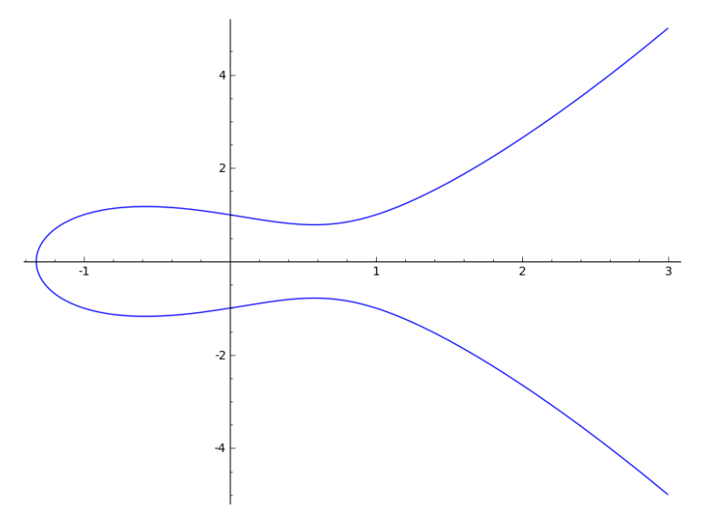
A Real Example
This simplified curve above is great to look at and explain the general concept of elliptic curves, but it doesn't represent what the curves used for cryptography look like.
For this, we have to restrict ourselves to numbers in a fixed range, like in RSA. Rather than allow any value for the points on the curve, we restrict ourselves to whole numbers in a fixed range.
When computing the formula for the elliptic curve (y² = x³ + ax + b), we use the same trick of rolling over numbers when we hit the maximum. If we pick the maximum to be a prime number, the elliptic curve is called a prime curve and has excellent cryptographic properties.

Slide 17
A Real Example (continued)
Here's an example of a curve (y² = x³ - x + 1) plotted for all numbers:

Slide 18
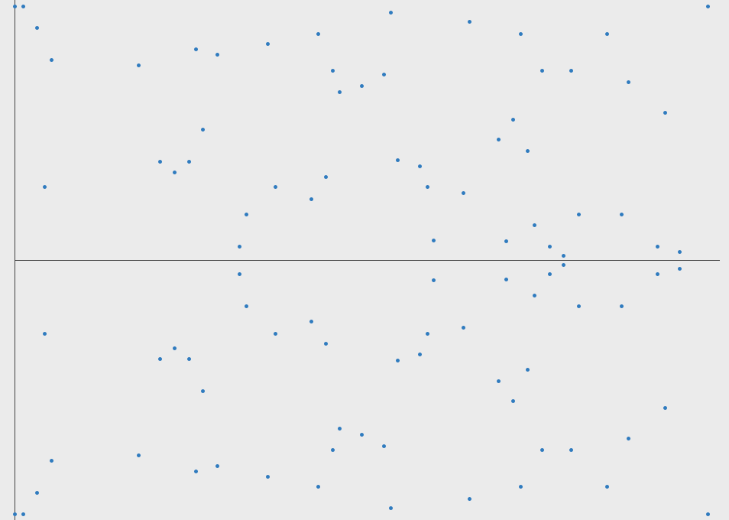
A Real Example (continued)
Here's the plot of the same curve with only the whole number points represented with a maximum of 97:

Slide 19
A Real Example (Continued)
This hardly looks like a curve in the traditional sense, but it is. It's like the original curve was wrapped around at the edges and only the parts of the curve that hit whole number coordinates are colored in. You can even still see the horizontal symmetry.

Slide 20
A Real Example (Continued)
In fact, you can still play the billiards game on this curve and dot points together. The equation for a line on the curve still has the same properties. Moreover, the dot operation can be efficiently computed.
You can visualize the line between two points as a line that wraps around at the borders until it hits a point. It's as if in our billiards game, when a ball hits the edge of the board (the max) then it is magically transported to the opposite side of the table and continues on its path until reaching a point.

Slide 21
A Real Example (Continued)
A dot B = C
With this new curve representation, you can take messages and represent them as points on the curve. You could imagine taking a message and setting it as the x coordinate, and solving for y to get a point on the curve. It is slightly more complicated than this in practice, but this is the general idea.
You get the points
(70,6), (76,48),(82,6), (69,22)

Slide 22
A Real Example (Continued)
A dot B = C
An elliptic curve cryptosystem can be defined by picking a prime number as a maximum (Key Size), a curve equation and a public point on the curve.
A private key is a number priv, and a public key is the public point dotted with itself priv times. Computing the private key from the public key in this kind of cryptosystem is called the elliptic curve discrete logarithm function.
This turns out to be the Trapdoor Function we were looking for.

Slide 23
What does it all mean?
The elliptic curve discrete logarithm is the hard problem underpinning elliptic curve cryptography. Despite almost three decades of research, mathematicians still haven't found an algorithm to solve this problem that improves upon the naive approach.
In other words, unlike with factoring, based on currently understood mathematics there doesn't appear to be a shortcut that is narrowing the gap in a Trapdoor Function based around this problem.
This means that for numbers of the same size, solving elliptic curve discrete logarithms is significantly harder than factoring. Since a more computationally intensive hard problem means a stronger cryptographic system, it follows that elliptic curve cryptosystems are harder to break than RSA and Diffie-Hellman.

Slide 24
03
02
04
01
1
Visualization
A Real Example
Any Downside?
Definition
What is an Elliptic Curve?
What is Elliptic Curve Cryptography?
Let’s see how it actually works
2
Strengths and Weaknesses
Practical Implications
Let’s see a real example
3
4

Slide 25
03
01
02
04
1
Visualization
Definition
A Real Example
Any Downside?
What is an Elliptic Curve?
What is Elliptic Curve Cryptography?
Let’s see how it actually works
2
Strengths and Weaknesses
Practical Implications
Let’s see a real example
3
4

Slide 26
02
03
01
04
1
A Real Example
Visualization
Definition
Any Downside?
What is an Elliptic Curve?
What is Elliptic Curve Cryptography?
2
Let’s see how it actually works
Strengths and Weaknesses
Practical Implications
Let’s see a real example
3
4

Slide 27
Let’s Visualize it
To visualize how much harder it is to break, Lenstra recently introduced the concept of "Global Security." You can compute how much energy is needed to break a cryptographic algorithm, and compare that with how much water that energy could boil. This is a kind of cryptographic carbon footprint.
By this measure, breaking a 228-bit RSA key requires less energy to than it takes to boil a teaspoon of water.
Comparatively, breaking a 228-bit elliptic curve key requires enough energy to boil all the water on earth. For this level of security with RSA, you'd need a key with 2,380-bits.

Slide 28
Let’s Visualize it
With ECC, you can use smaller keys to get the same levels of security. Small keys are important, especially in a world where more and more cryptography is done on less powerful devices like mobile phones.
While multiplying two prime numbers together is easier than factoring the product into its component parts, when the prime numbers start to get very long even just the multiplication step can take some time on a low powered device.
While you could likely continue to keep RSA secure by increasing the key length that comes with a cost of slower cryptographic performance on the client. ECC appears to offer a better tradeoff: high security with short, fast keys.

Slide 29
Elliptic Curves in Action
After a slow start, elliptic curve based algorithms are gaining popularity and the pace of adoption is accelerating. Elliptic curve cryptography is now used in a wide variety of applications: the U.S. government uses it to protect internal communications.
The Tor project uses it to help assure anonymity, it is the mechanism used to prove ownership of bitcoins.
It provides signatures in Apple's iMessage service.
It is the preferred method for authentication for secure web browsing over SSL/TLS.
First generation cryptographic algorithms like RSA and Diffie-Hellman are still the norm in most arenas, but elliptic curve cryptography is quickly becoming the go-to solution for privacy and security online.

Slide 30
03
02
04
01
1
Visualization
A Real Example
Any Downside?
Definition
What is an Elliptic Curve?
What is Elliptic Curve Cryptography?
Let’s see how it actually works
2
Strengths and Weaknesses
Practical Implications
Let’s see a real example
3
4

Slide 31
03
01
02
04
1
Visualization
Definition
A Real Example
Any Downside?
What is an Elliptic Curve?
What is Elliptic Curve Cryptography?
Let’s see how it actually works
2
Strengths and Weaknesses
Practical Implications
Let’s see a real example
3
4

Slide 32
02
03
01
04
1
A Real Example
Visualization
Definition
Any Downside?
What is an Elliptic Curve?
What is Elliptic Curve Cryptography?
2
Let’s see how it actually works
Strengths and Weaknesses
Practical Implications
Let’s see a real example
3
4

Slide 33
03
02
04
01
1
Visualization
A Real Example
Any Downside?
Definition
What is an Elliptic Curve?
What is Elliptic Curve Cryptography?
Let’s see how it actually works
2
Strengths and Weaknesses
Practical Implications
Let’s see a real example
3
4

Slide 34
The Downside ??
There have been some questions and uncertainties that have held them back from being fully embraced by everyone in the industry.
One point that has been in the news recently is the Dual Elliptic Curve Deterministic Random Bit Generator (Dual_EC_DRBG). This is a random number generator standardized by the National Institute of Standards and Technology (NIST), and promoted by the NSA.
Dual_EC_DRBG generates random-looking numbers using the mathematics of elliptic curves. The algorithm itself involves taking points on a curve and repeatedly performing an elliptic curve "dot" operation. After publication it was reported that it could have been designed with a backdoor, meaning that the sequence of numbers returned could be fully predicted by someone with the right secret number.
Recently, the company RSA recalled several of their products because this random number generator was set as the default PRNG for their line of security products. Whether or not this random number generator was written with a backdoor or not does not change the strength of the elliptic curve technology itself, but it does raise questions about the standardization process for elliptic curves.

Slide 35
The Downside ??
Another uncertainty about elliptic curve cryptography is related to patents. There are over 130 patents that cover specific uses of elliptic curves owned by BlackBerry (through their 2009 acquisition of Certicom).
Many of these patents were licensed for use by private organizations and even the NSA. This has given some developers pause over whether their implementations of ECC infringe upon this patent portfolio.
In 2007, Certicom filed suit against Sony for some uses of elliptic curves, however that lawsuit was dismissed in 2009.
There are now many implementations of elliptic curve cryptography that are thought to not infringe upon these patents and are in wide use.

Slide 36
The Downside ??
The ECDSA digital signature has a drawback compared to RSA in that it requires a good source of entropy. Without proper randomness, the private key could be revealed.
A flaw in the random number generator on Android allowed hackers to find the ECDSA private key used to protect the bitcoin wallets of several people in early 2013.
Sony's Playstation implementation of ECDSA had a similar vulnerability. A good source of random numbers is needed on the machine making the signatures. Dual_EC_DRBG is not recommended.

Slide 37
Looking Ahead
Even with the above cautions, the advantages of elliptic curve cryptography over traditional RSA are widely accepted. Many experts are concerned that the mathematical algorithms behind RSA and Diffie-Hellman could be broken within 5 years, leaving ECC as the only reasonable alternative.
Elliptic curves are supported by all modern browsers, and most certification authorities offer elliptic curve certificates. Every SSL connection will default to ECC on a modern browser. Soon, CloudFlare will allow customers to upload their own elliptic curve certificates. This will allow ECC to be used for identity verification as well as securing the underlying message, speeding up HTTPS sessions across the board. More on this when the feature becomes available.

Slide 38
04
Any Downside?
Strengths and Weaknesses
Practical Implications
4

Slide 39
03
Visualization
Let’s see how it actually works
3

Slide 40
02
A Real Example
2
Let’s see a real example

Slide 41
01
1
Definition
What is an Elliptic Curve?
What is Elliptic Curve Cryptography?

